Slide 1
Protein Synthesis
Lecture 18

Slide 2
Objectives
define the terms codons, anticodon, exon, introns, genetic code, coding strand, non-coding strand
describe briefly the processes of transcription & translation
know what promoters, transcription factors, and RNA polymerase are
describe the role of DNA, mRNA, tRNA, and ribosomes in the process of protein synthesis

Slide 3
Cell Biology Overview of Protein Synthesis from Stimulus to Product
S. M. Halloran
Prepared especially for Life Chiropractic College West

Slide 4
Overview of Protein Synthesis
Cell signaling
Transcription and its components (some detail)
Translation and its components (some detail)
Targeting: how the finished protein knows where to go

Slide 5
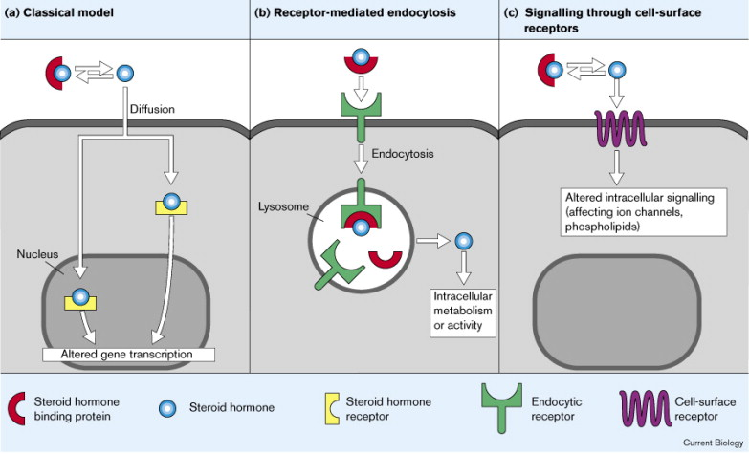
Signal from Outside
stimulus: agonist (ligand) binds to a specific receptor
protein, peptide hormone: insulin, TSH, etc
receptor often at cell membrane surface
sometimes receptor within the cell
steroids can cross cell membranes to bind to internal receptor

Slide 6
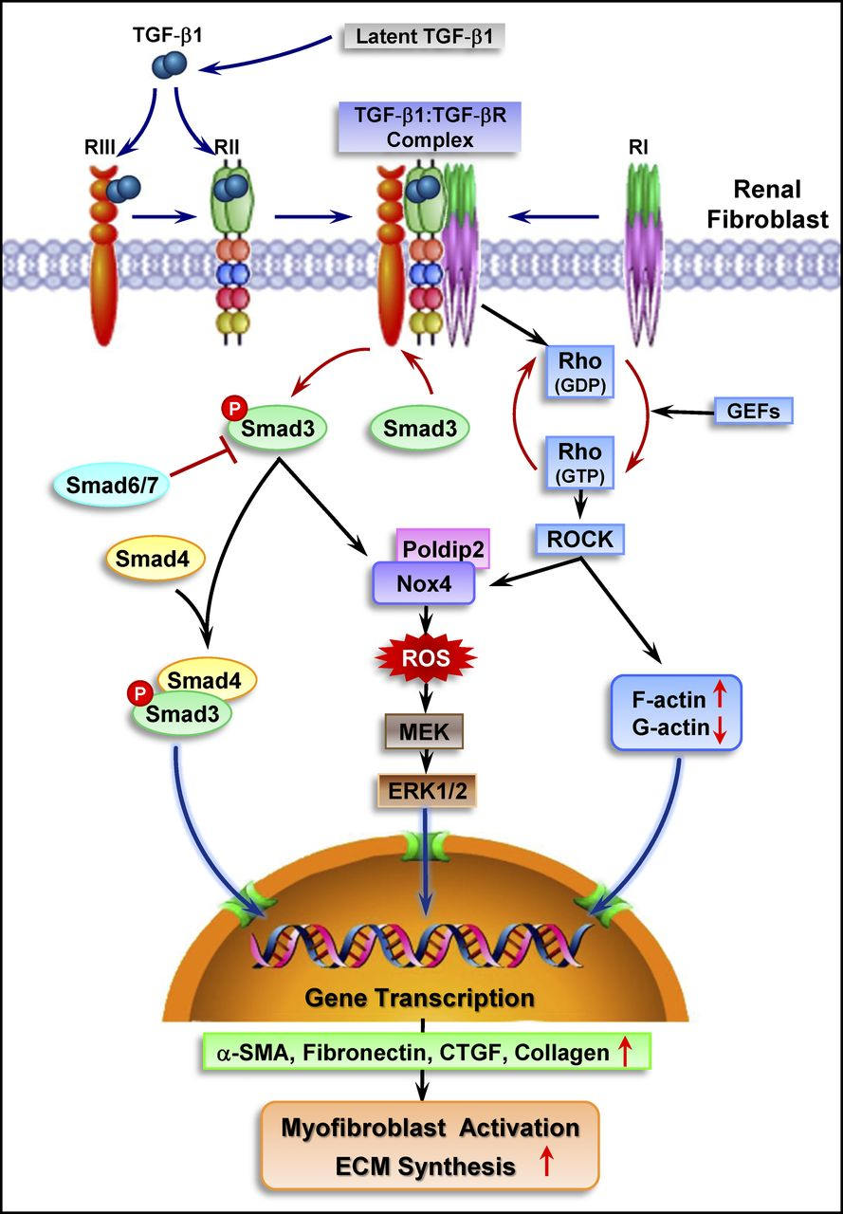
Intracellular Signal Transduction
The stimulus activates one or more signalling or metabolic pathways
These pathways create both immediate and delayed changes
"2nd messengers": the molecules between the signal point and the target
The delayed changes involve turning on the gene expression system

Slide 7
Regulation of Protein Activity
These signaling pathways typically cause a change an immediate change in cell function
e.g. release of vesicle contents or activation of enzymes for digestion
Proteins already there & quiescent
Modifications (phosphorylation) of proteins to turn on or off
Other proteins may need to be synthesized
Delayed process, takes more time

Slide 8
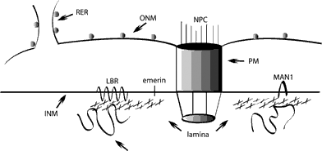
To & Into The Nucleus
Some of activated signaling proteins are involved in stimulating transcription
They cross pores in nuclear membrane and find their way to DNA to start transcription of certain genes
Some other signals for gene transcription might be transmitted through nuclear membrane in receptor-mediated way just like signals through plasma membrane: 3rd messenger

Slide 9
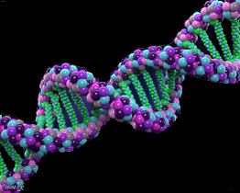
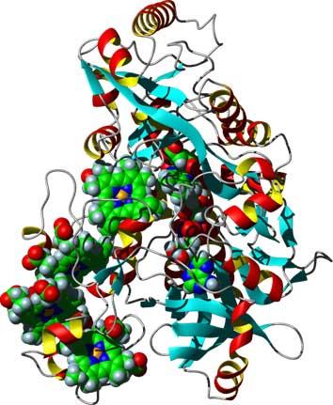
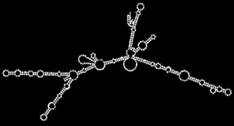
Central Dogma
transcription translation
DNA RNA Protein
Proposed by Crick (1958)

Slide 10
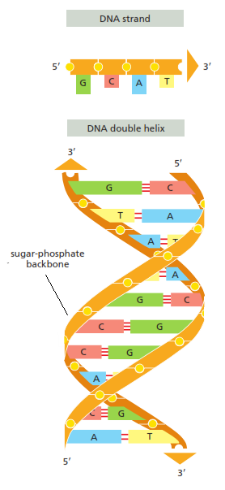
DNA
four nitrogenous bases
adenine (A)
thymine (T)
cytosine (C)
guanine (G)
2-deoxyribose-phosphate copolymer
base pairing
A = T
G ≡ C
helical arrangement of two polymers
5′ → 3′
major and minor grooves

Slide 11
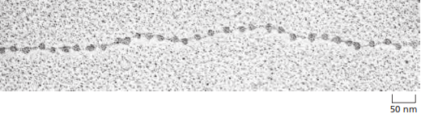
Organization of Genome
nucleus (in eukaryotes)
the chromosome
one single long DNA molecule
proteins that coil, pack the chromosome
in metaphase of mitosis, chromosomes packed even more densely to achieve goal
with proper staining, chromosomes visible in microscope

Slide 12
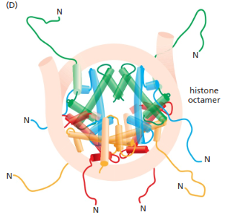
Nucleosome
1st level of "organizing" by compaction/coiling
DNA wrapped in left-hand coil 1.7 turns with 11 nm diameter
Basic histone proteins bind DNA and to each other
Core is octamer of histones H2A (red), H2B (orange), H3 (green), H4 (blue)
"Chromatin remodeling"
ATP-dependent sliding of nucleosome to expose DNA to other proteins for transcription

Slide 13
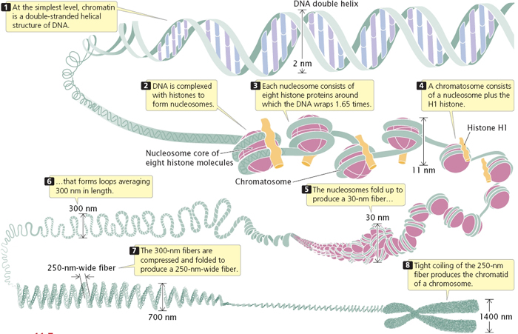
Eukaryotic Chromosome Structure
https://karimedalla.files.wordpress.com/2012/11/pierce_11_5_large_2.jpg

Slide 14
Human Genome Facts
The gene is fundamental unit of biological traits (heredity)
1.5% of DNA codes for protein (as exons)
21,000 protein-coding genes
Average of ~27,000 bp per gene
9000 RNA genes
Exons in genes: range 1-178

Slide 15
Transcription & Components
In eukaryotes, transcriptional process is on single gene
The final product of a gene can be a protein or RNA
RNA products typically involved in gene expression or organizing genome structure
Promoters
Sequences of DNA marking point where transcription should start
Transcription Factors
proteins that bind to polymerase enzyme & DNA to initiate transcription
RNA polymerase
the enzyme that reads to DNA and makes the RNA (polymer)

Slide 16
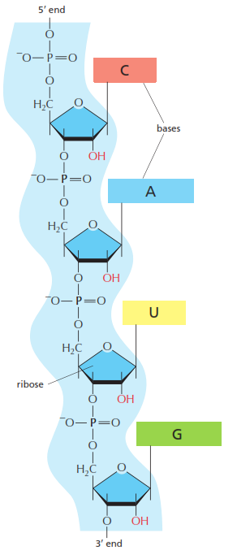
RNA
four nitrogenous bases
adenine (A)
uracil (U) [representing T in DNA!]
cytosine (C)
guanine (G)
ribose-phosphate copolymer
single-stranded
but self-complementary pairing occurs

Slide 17
Types of RNA
ribosomal RNA (rRNA) (80% of E coli's RNA!)
transfer RNA (tRNA)
messenger RNA (mRNA)
small nuclear RNA (snRNA)
small nucleolar RNA (snoRNA)
microRNA (miRNA)
small interfering RNA (siRNA)
piwi-interacting RNA (piRNA)
long noncoding RNA (lncRNA)

Slide 18
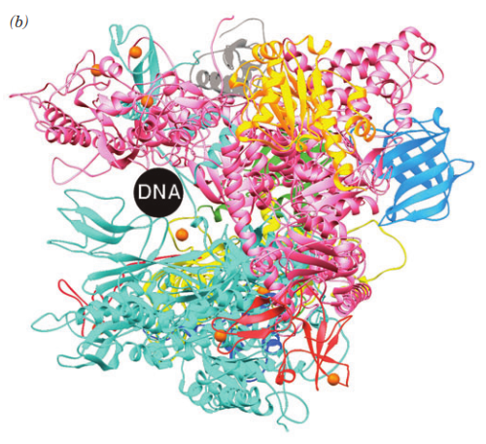
RNA Polymerases
Three types of RNA polymerases in eukaryotes
RNA polymerase I
ribosomal RNA genes (5.8S, 18S, 28S)
RNA polymerase II
protein-coding genes (mRNAs)
genes for snoRNA, miRNA, siRNA, lncRNA, most snRNA
RNA polymerase III
tRNA genes, 5S rRNA, few snRNA, other small RNA
Voet et al (2013) Fundamentals of Biochemistry, 4ed
Yeast RNA polymerase II

Slide 19
Initiation of Transcription of mRNA
DNA-binding proteins called transcription factors bind to a special DNA sequence called the promoter
The transcription factors (TFs) acquired the ability to bind to the promoter usually as the end result of a signaling pathway, for example, the TFs were phosphorylated by a protein kinase
The TFs assemble in a certain order on the promoter, and they bring in a huge enzyme called RNA polymerase II (RNAP2): one of the TFs also starts separating the helix so that RNAP2 can bind to the noncoding strand, which is the DNA strand that is the template for making the pre-mRNA
The coding strand will actually be the sequence of the pre-mRNA (think about that!)

Slide 20
More Detail About Initiation
TATA-binding protein (TBP) subunit within TFIID holoprotein binds to TATA sequence on DNA
Binding believed to cause kink that attracts other proteins
TATA sequence 25 nt upstream of transcriptional start
TFIIB joins the complex
TFIIE, TFIIH, and TFIIF-associated RNA polymerase II assemble to join complex
TFIIH binds to ATP to use energy to open DNA strand and modifies (phosphorylation) the polymerase on its C-terminal domain to release from factors

Slide 21
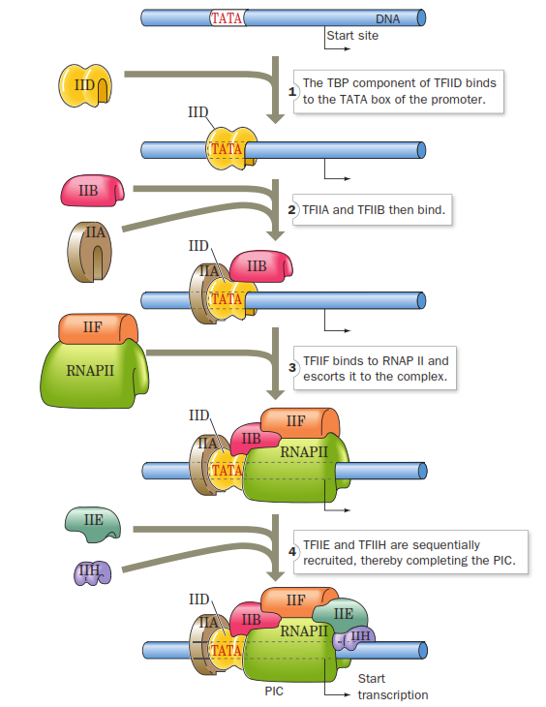
Transcriptional Initiation
Elements (sequences) on DNA
DNA-binding proteins: "transcription factors"
TFIIA, TFIIB, TFIIC, etc
TFII = transcription factor for polymerase II
RNA polymerase II
DNA-dependent RNA polymerase

Slide 22
Other Initiation Facts
Transcriptional activators (proteins) must bind to enhancers (DNA sequences) to direct RNApol II to binding site
Mediator is required protein complex mediating interactions between polymerase and TFIIs
Enzymes that modify chromatin and histones to open access to DNA required
Histone acetylase enzymes diminish strong + charges on Lys/Arg residues
RNA polymerase II must be released from this large assembly of proteins to begin elongation (polymerization)

Slide 23
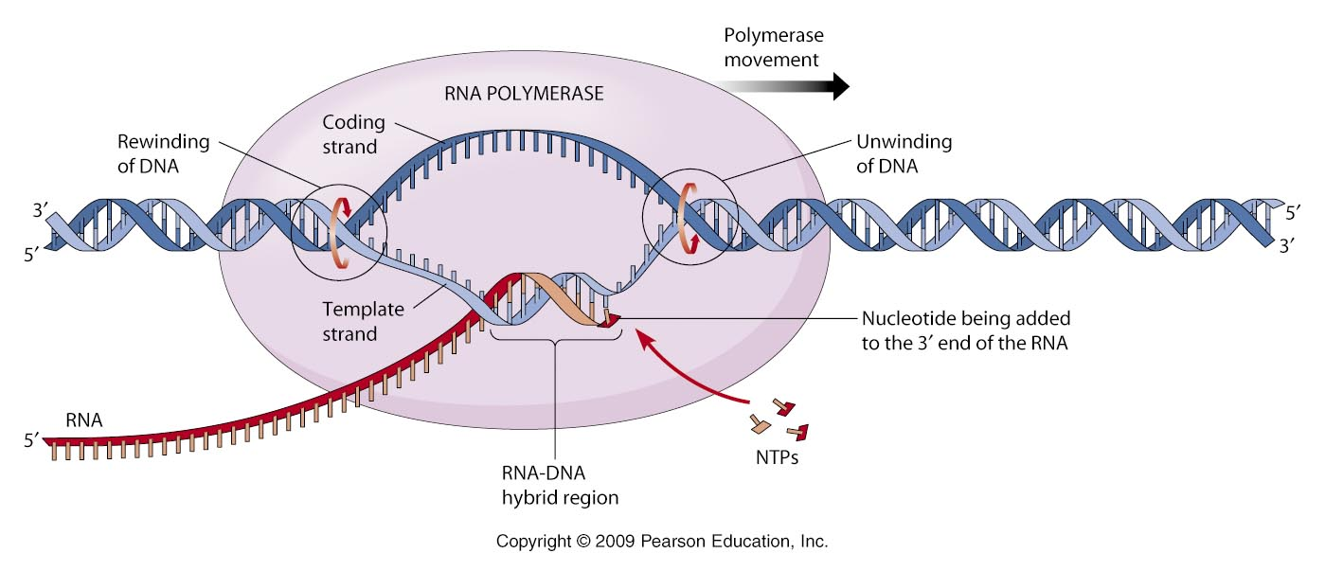
Transcriptional Elongation
RNA polymerase pairs bases as ribonucleotide triphosphates (NTPs) on template (anti-sense) strand
Base is attached to growing RNA polymer using energy from hydrolysis of triphosphate (product: pyrophosphate)
Unwinding of DNA ahead of polymerase via TFIIH helicase activity, which uses ATP
The coding (sense) strand of the DNA is the sequence of RNA produced (but uracil [U] where thymine [T] is)

Slide 24
Transcriptional Elongation Details
After adding a few bases, RNAP II goes to "elongation mode"
TFIIB finger domain is displaced (otherwise hits growing RNA chain)
C-terminal domain of Rpb1 subunit gets phosphorylated, which probably releases hold of polymerase on several general transcription factors (GTFs)
GTFs remain bound and may quickly direct 2nd RNAP II to start site
Elongator hexamer binds to Rbp1 CTD and increases transcription speed

Slide 25
Transcriptional Termination
Molecular details remain to be determined
that is, they are unknown to scientists
An endonuclease (possibly bound to polymerase complex) recognizes transcript sequences during polymerization
The nascent RNA gets cleaved, and appears to stop further polymerization

Slide 26
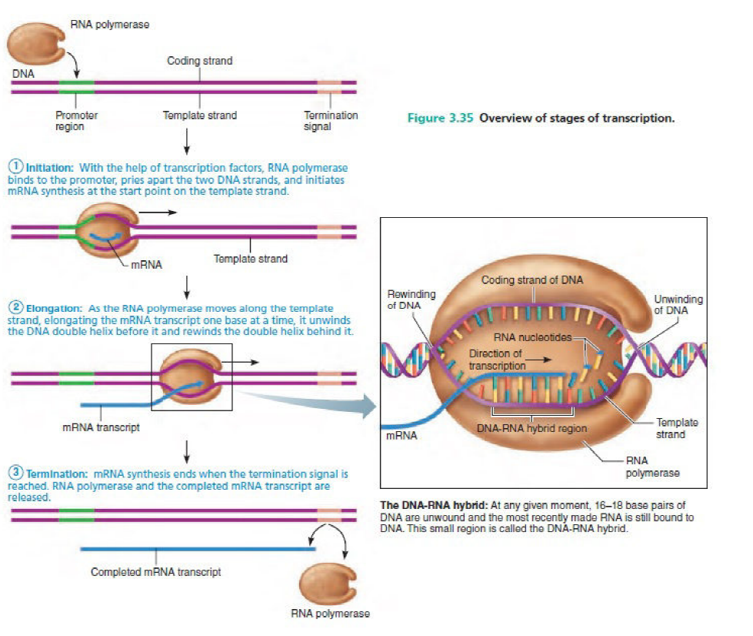

Slide 27
Pre-mRNA: Introns & Exons
The new transcript in eukaryotes (unlike prokaryotes) is not ready for protein synthesis
The RNA (pre-messenger RNA / pre-mRNA) has internal sequences called introns that are NOT going to be part of protein coding sequence
Introns are removed using splicing
many kinds of splicing mechanisms in eukaryotes
All the protein-coding sequences are in exons, which will remain and be joined to each other after splicing

Slide 28
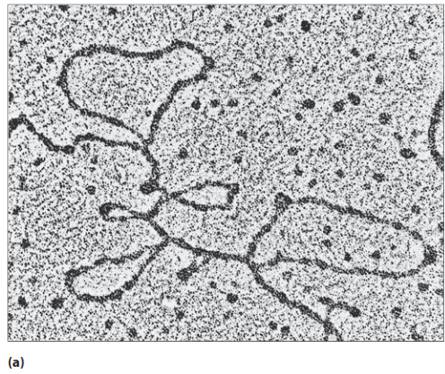
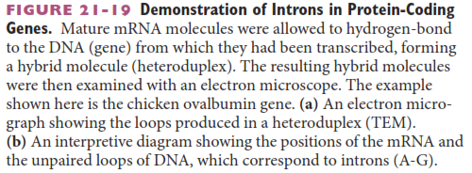
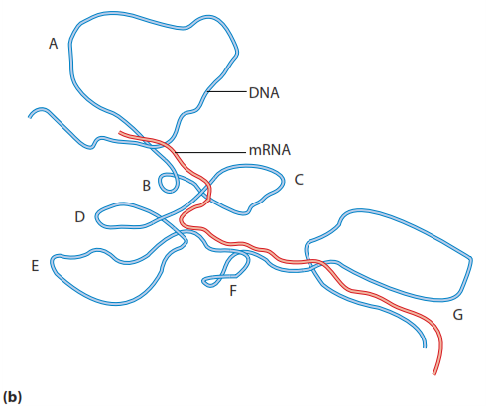
Proof of Introns

Slide 29
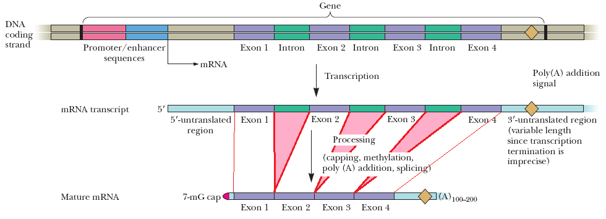
Maturation of mRNA
Pre-mRNA intron splicing
Joining the coding segments (exons)
Capping the 5' end of mRNA with 7-methylGTP
Poly(A) Tailing of the 3' end of mRNA
required for efficient translation by ribosome complex
stabilizes mRNA against degradation

Slide 30
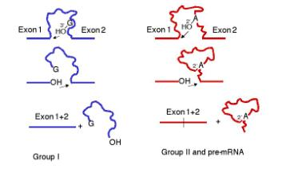
Intron Splicing: Self-Splicing
Self-splicing introns revealed that RNA possesses intrinsic catalytic activity
Typically the RNA folds to form self-pairing stems (2° structure) to create juxtaposition of atoms that leads to the chemical activation causing two-step transesterification reactions
Reactions may be assisted by metal cofactors and proteins that direct RNA folding structure

Slide 31
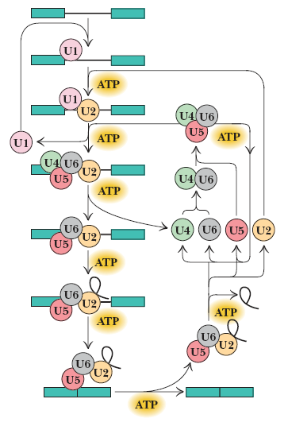
Intron Splicing: Spliceosomes
set of ribonucleoproteins (snRNPs) that bind specifically to pre-mRNA sequences at 5'-intron border & within intron
catalyze the formation of a "lariat" loop of the intron, then a transesterification reaction that joins 3' end of upstream exon to 5' end of downstream exon

Slide 32
Posttranscriptional Regulation
All about deciding whether mRNA proceeds to translation
Eukaryotic mRNAs long-lived
Rather than degradation, just shut down or put "on hold"
Controlling mRNA degradation
RNA interference
RNA that inhibits or targets mRNA for degradation
too broad a subject for scope

Slide 33
mRNA Degradation
mRNA stability
5′ m7-GDP cap
Poly(A) tail
Internal sequences
Degradation features
Half life of transcripts from few minutes to hours & days
Cytosolic deadenylases remove poly(A) tail
mRNA-stabilizing poly(A)-binding protein no longer binds
Decapping enzymes activated when no poly(A) protein
Degradation systems
Xrn1 : 5′ → 3′ exonuclease
Exosome : 3′ → 5′ exonuclease complex
P body : decapper + 5′ → 3′ exonuclease + accessory proteins

Slide 34
mRNA Degradation
AU-rich elements (AREs)
In the 3′-UTR
Can increase or decrease degradation rate
Both RNA-binding proteins and 2° structure play role in controlling stability/degradation

Slide 35
Transcription Summary
State of DNA
Bound by chromatin proteins & RNA and folding of DNA to inactivate transcriptional state ("no go")
DNA sequences ("elements") giving the home address of a gene
promoters, enhancers
RNA polymerase
Different types for the types of RNA species
Proteins (transcription factors) regulating when and where (and how) to hold RNA polymerase by the hand to the transcription start site

Slide 36
Overview of Translation
Translation from the amino- (N-)terminal of polypeptide to carboxyl (C-) terminal
A "genetic code" translating sequence of 3 bases to one amino acid is used
Translation process itself has three phases
Initiation
Elongation
Termination
Hmmm, just like transcription…
Do you think many biological processes are described in this way?

Slide 37
Codons & Anticodons
Codons and anticodons represent a sequence order of three RNA bases
Codons are found on the mRNA, which will code for the entire polypeptide: that is, mRNA is translated to produce the polypeptide
Anticodons are three RNA bases in sequence that will pair up with codons during translation
The pairing is similar to DNA-base pairing
Anticodons are found on a loop (the "anticodon loop") of the tRNA molecule, which is responsible for helping to match the mRNA codon with the amino acid that will become part of the polypeptide

Slide 38
Why 3 RNA Bases = 1 Codon?
There are 20 natural amino acids, so we must have at least 20 unique codons (3-base sequences)
There are only 4 RNA bases
If it were 1 RNA base → 1 codon → 1 amino acid in translation, we can code only 4 codons = 4 amino acids in a polypeptide
If it were 2 RNA bases → 2 codons → 1 amino acid, we can code for 4² = 16 amino acids…still not enough
With 3 RNA bases → 1 amino acid, we can code for 4³ = 64 possible amino acids
Nature knows how to do math

Slide 39
Fully Ready Eukaryotic mRNA
The fully mature/ready mRNA should feature in 5'→3' order the following:
the 5'-G cap
tens-to-dozens of RNA bases that represent the 5'-untranslated region (5'-UTR)
the start of translation at the AUG (Met) start codon
the translated region that will code for the polypeptide
a stop codon: which codes for no amino acid
tens-to-dozens of RNA bases that represent the 3'-untranslated region (3'-UTR)
a poly-adenylate (poly-A) tail
The mRNA is shipped out from the nucleus to the cytoplasm

Slide 40
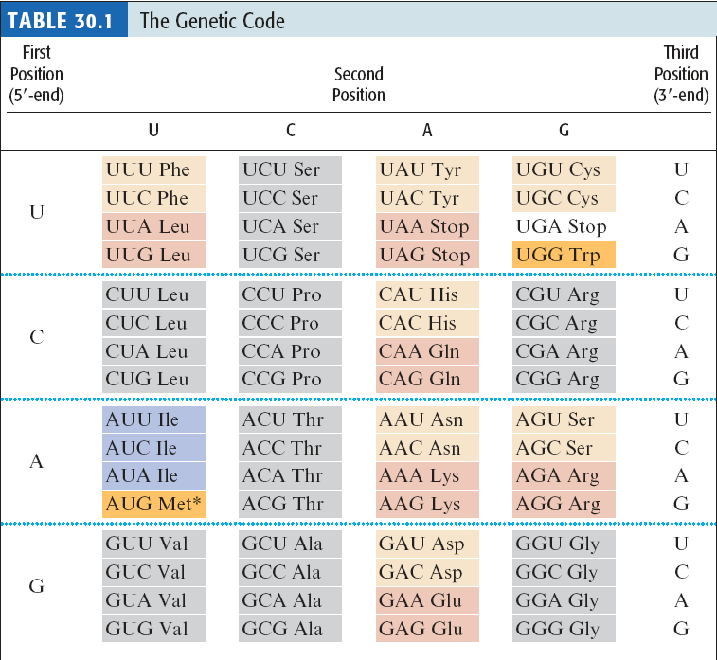
The Genetic Code
64 possible codon permutations
20 natural amino acids 61 codons used for them
3 codons are "nonsense" (stop)
many degenerate codings
amino acids with more than 1 codon
usually 3rd base of codon source of degeneracy
"universal"
pretty much every organism from primitive bacteria to humans uses it

Slide 41
Translation Initiation Components
the capped & tailed mRNA
12 soluble protein factors involved
eIFs "eukaryotic initiation factors"
initiator tRNA: tRNA^{Met}
the ribosome
two subunits
40S subunit
33 proteins (S1-S33) + 18S rRNA
60S subunit
49 proteins (L1-L49) + 3 rRNAs: 28S, 5S, 5.8S
lots of ATP and GTP

Slide 42
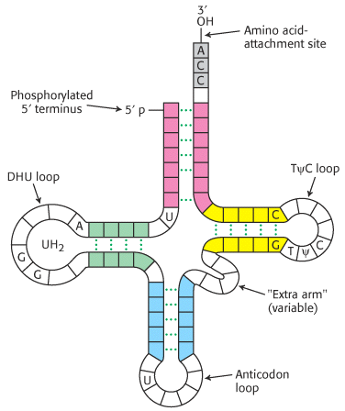
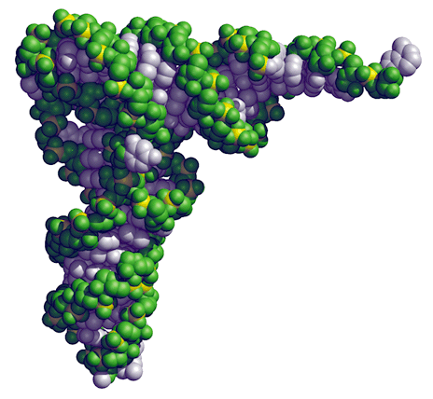
tRNA
dozens of species in cells
Structure
3 stem-loop pairing structures ("arms")
loop in anticodon arm recognizes mRNA codon
3′ end of acceptor stem binds to specific amino acid
Aminoacyl-tRNA synthetases are enzymes that recognize tRNA and couple (using ATP) to proper amino acid
Some redundancy
20 amino acids 64 possible anticodons
Berg, Tymoczko & Stryer, Biochemistry, 5th ed., 2001

Slide 43
Translation Initiation
Ribosome-mRNA complex features 3 sites
A: tRNA acceptor site
P: peptidyl-tRNA site
E: exit site
40S ribosome subunit + initiation factors
tRNA^{Met} binds to complex formed in 1
Complex 1 + 2 bind to 5' cap of mRNA and "scan" to AUG codon on mRNA
60S ribosome subunit joins complex in 3 waiting at AUG
proceed to translation elongation

Slide 44
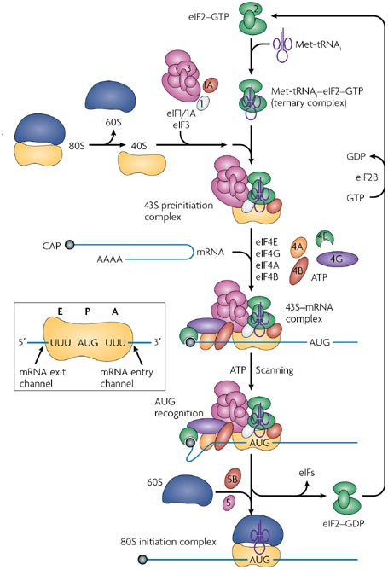
Translation Initiation Detail
40S ribosome subunit + eIF3 + eIF1A → [A]
eIF2•GTP•tRNA^{Met} complex formation → [B]
join [A] to [B]
activated mRNA + eIF4A, eIF4B, eIF4H, eIF4F → [C]
eIF4F = (cap binding protein) heterotrimer of eIF4E, eIF4G, eIF4A
join [C] to [A•B] {all these on 5' cap}
scan assembly [A•B•C] to AUG codon
uses ATP
eIF2 hydrolyzes GTP, released
eIF5 binds
Other initiating factors released
eIF5 binds & hydrolyzes GTP
60S ribosome subunit binds
80 initiation complex ready

Slide 45
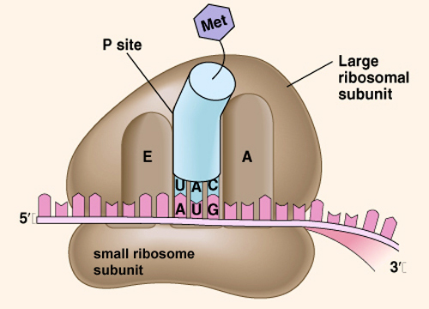
Translation Elongation
Ribosome-mRNA complex features 3 sites
A: tRNA acceptor site
P: peptidyl-tRNA site
E: exit site

Slide 46
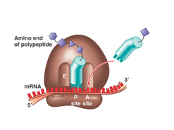
Translation Elongation: Decoding
Step 1: aminoacyl-tRNA enters A site codon-anticodon matching

Slide 47
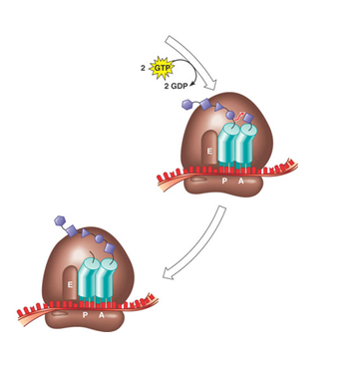
Translation Elongation: Transpeptidation
Step 2: GTP-mediated transfer (transacylation) of the C-terminus of peptide on tRNA in P site to the N-terminus of amino acid on tRNA at A site

Slide 48
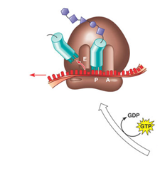
Translation Elongation: Translocation
Step 3: GTP-mediated sliding of the mRNA through the ribosome with movement of P-site tRNA to E site, and A-site tRNA to P site, and E site tRNA leaving

Slide 49
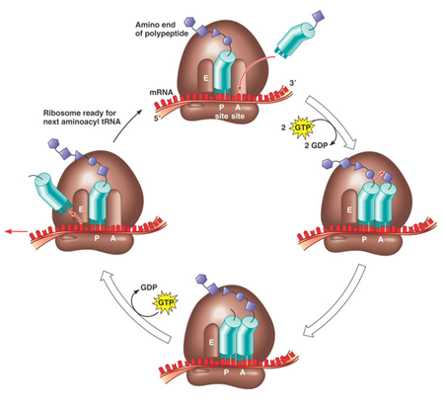
Translation Elongation: The Whole Cycle
many soluble protein elongation factors involved
moving components to right places
sliding (ratcheting) the mRNA
verifying integrity of the translation
energy is consumed (GTP)

Slide 50
Translation Termination
A stop codon (UAG, UGA, UAA) is encountered in the A site
A release factor (just one for all eukaryotes, unlike prokaryotes) binds to the translation complex
The release factor, eRF1, looks like a tRNA molecule
probably has hydrolytic activity
enters the A site when there is stop codon
an H₂O molecule instead of amino acid hydrolyzes the polypeptide-tRNA bond, releasing it
another unknown tRNA-like release factor may signal breakup of ribosome assembly into its two subunits

Slide 51
Translation Summary
Initiation
Binding of first tRNA to preinitiation complex with 40S ribosome subunit and mRNA
Scanning to AUG start codon site
60S ribosome subunit binding to complete assembly
Elongation
Decoding: Binding aa-tRNA to A site
Transpeptidation: peptide bond of long chain C-terminal to N-terminal of A-site amino acid
Translocation: sliding mRNA and with tRNAs
Termination
Stop codon met
Release factor frees the polypeptide, disassemble ribosome

Slide 52
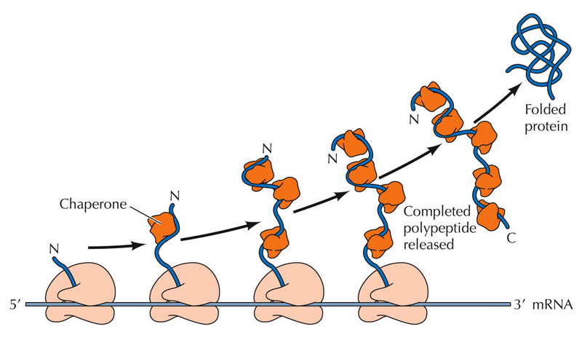
Posttranslational Processing
Folding
Proteins have secondary (2°) & tertiary (3°) structure
Generally sequence itself has information for its own folding
Some folding assisted by "chaperone" and "chaperonin" proteins
These are heat-shock proteins (Hsp70 family)

Slide 53
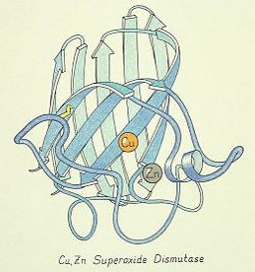
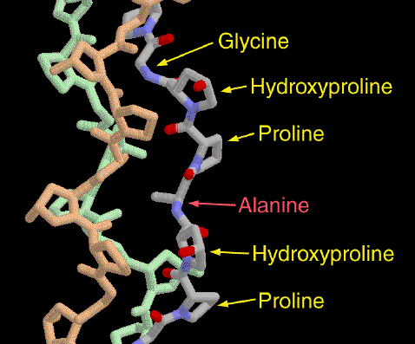
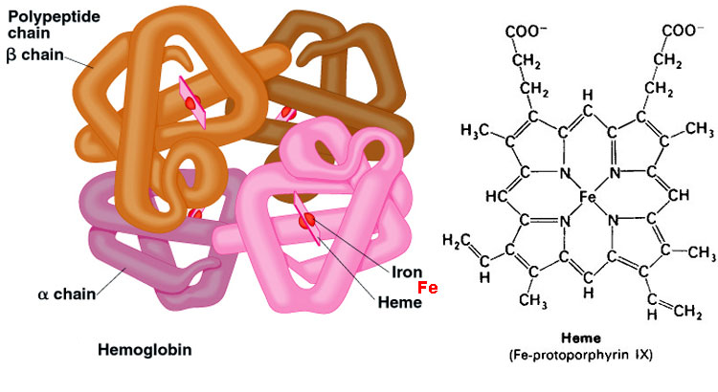
Posttranslational Processing
Chemical modifications
Formation of disulfides: linked with folding
Association with coenzymes, cofactors
Sulfation/sulfonation, acetylation, oxidation/hydroxylation, phosphorylation, …
hemoglobin subunits → Fe²⁺-bound heme porphyrin ring
collagen prolines → hydroxylated
Zn²⁺, Cu²⁺ → superoxide dismutase (SOD)

Slide 54
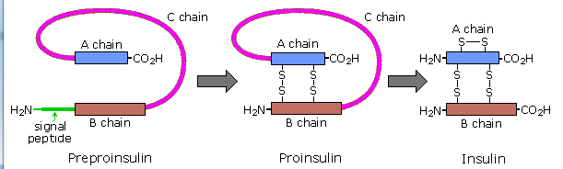
Posttranslational Processing
Proteolytic processing
Proteases are proteolytic enzymes that usually specifically recognize an amino acid sequence, then cut one of peptide bonds
trypsin recognizes cationic residues (Arg, Lys), cuts on C-side
insulin: pre form → pro form → active form
Defective polypeptides posttranslation are often marked for degradation: ubiquitin + proteasome processing, others

Slide 55
Protein Targeting
Synthesized protein must go to its correct location
Within the cell?
cytosol
plasma membrane
membranous organelles: nucleus, mitochondria, lysosomes
Outside the cell?
secretory proteins
structural: extracellular matrix
defense: immunoglobulins, complement, interferons

Slide 56
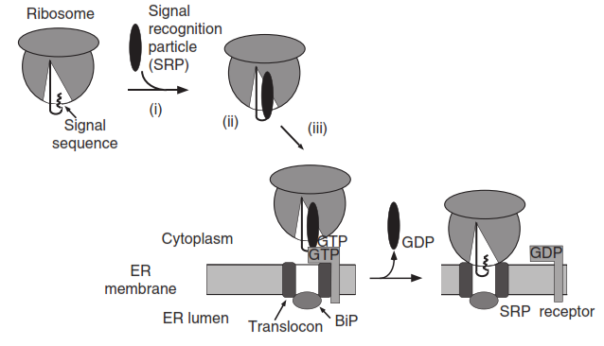
ER-Targeted Proteins
Signal peptide present in N-terminus of polypeptide
During translation, signal peptide synthesized, binds to signal recognition particle (SRP)
Ribosome-peptide-SRP complex binds to docking protein site (SRP receptor) on endoplasmic reticulum (ER) membrane using GTP

Slide 57
ER-Targeting Facts
Signal peptides quite variable in sequence, but 20-30 aa long with 8-12 aa core, cationic N-residues, uncharged polar C-residues
SRP is a rod-shaped complex of 300 nt 7S RNA + 6 proteins from 9-72 kDa with GTPase activity
SRP recognizes signal peptides that fits in an M-domain groove of highly conserved SRP54 protein

Slide 58
Threading ER Protein Out
Polypeptide synthesis resumes with chain going out of cytosol into lumen of ER
Oligosaccharides are added in lumen to polypeptide
N-glycosylations: amide groups on asparagine
O-glycosylations: hydroxyl group of serine, threonine
Glycosylations have "signal sequences" too
Glycoprotein maturation
Vesicles from ER move to cis-side of Golgi
Glycan-modifying enzymes remove or modify saccharides at "antenna" termini or internal branch points
Vesicles from Golgi move to organelles or to cell membrane surface for constitutive or regulated secretion

Slide 59
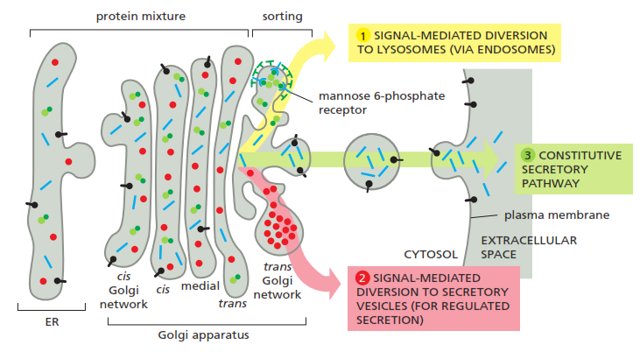
Protein Maturation Through Golgi

Slide 60
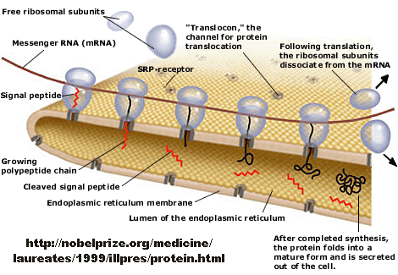
Secretory Protein Synthesis Visualized

Slide 61
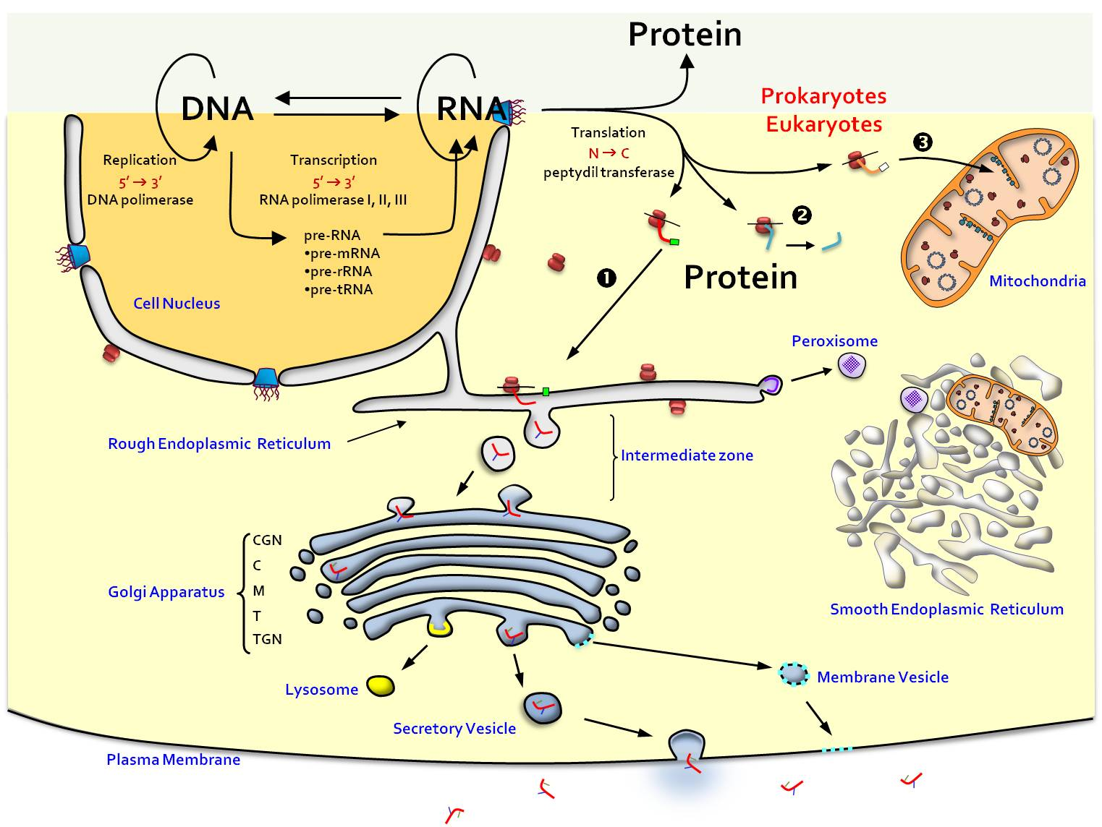
Membranous Organellar Proteins
The image shows how some membranous organelles get their proteins and their origins
http://www.intechopen.com/books/oxidative-stress-and-chronic-degenerative-diseases-a-role-for-antioxidants/cell-nanobiology

Slide 62
Protein Targeting Summary
Many possibilities for final destination of proteins
organelles: mitochondria, nucleus, peroxisomes
cytosol
plasma membrane
extracellular location
Secreted proteins synthesized and processed on endoplasmic reticulum (ER) membrane
Glycoproteins
initial oligosaccharide attachment in ER
trimming & modification of sugar passing through Golgi

Slide 63
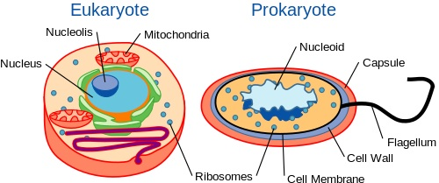
Prokaryote vs. Eukaryote
Prokaryotes
No nucleus
1 circular chromosome: relatively less coiled, no nucleosomes (histones)
Only one RNA polymerase, three termination factors, no enhancers
mRNA has no cap, poly(A) tailing and typically multiple genes with related function (operon)
Translated polypeptide also has multiple proteins often (polyprotein), trimmed to separate proteins

Slide 64
Relevance To You?
scientific foundation
cell biology → diagnosis → therapy physiology
a brilliant thought? explore it in biomedical research while in practice
collaborate, join/form a team (strength in numbers)

Slide 65
Thanks to
You the audience
Drs. Donaldson and Ray

Slide 66
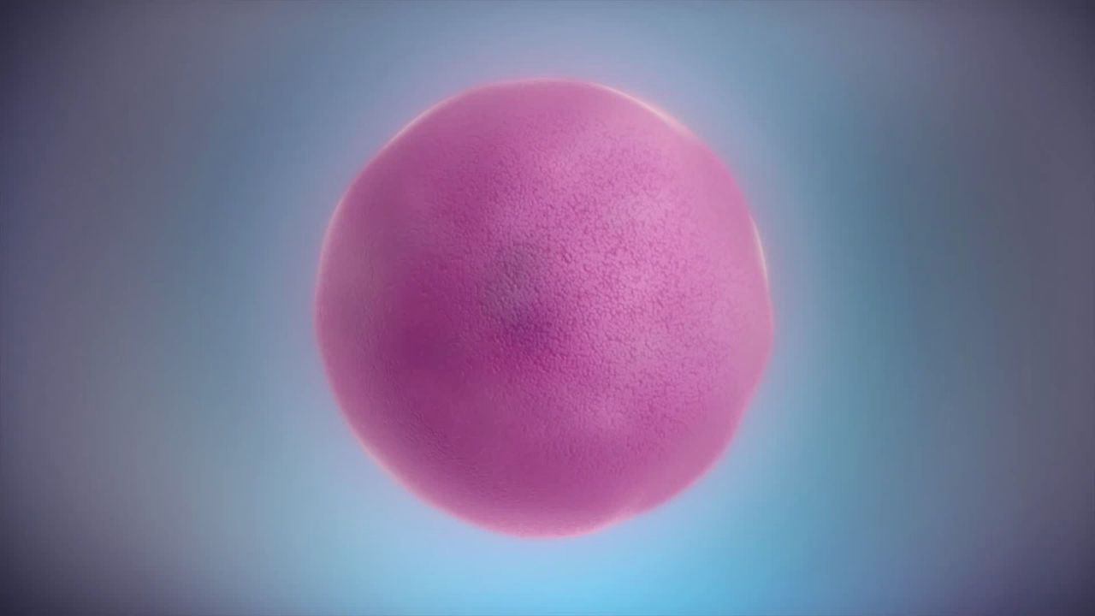

Slide 67
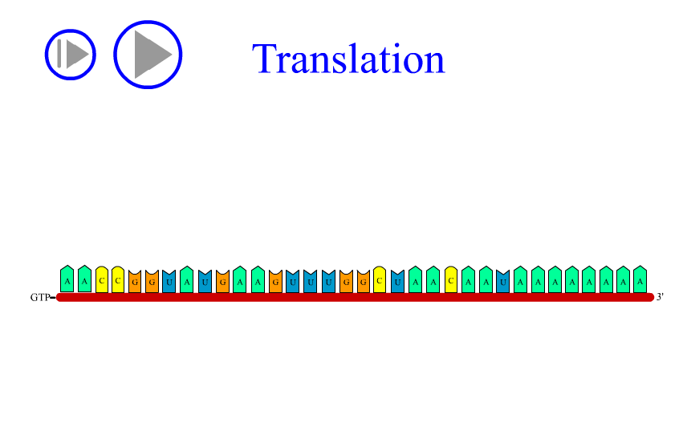

Slide 68
Sources
Alberts et al, Molecular Biology of The Cell, 6th Ed (2015)
Voet et al, Fundamentals of Biochemistry: Life at The Molecular Level, 4th Ed (2013)
Dalbey & von Heinje, Protein Targeting Transport & Translocation (2002)
/

Slide 69
Net-based Image Credits
DNA molecule
https://www.lordofthecraft.net/topic/109204-descension-20
RNA molecule
http://www.phys.ens.fr/~wiese/highlights/RNA-folding.html
Protein molecule
http://www.nuggetnetreview.com/m-first-church-of-atheism.htm
Translation APE sites & Elongation Cycle
http://myibbiology.blogspot.com/2014/03/topic-74-translation.html
/

